Slide 1
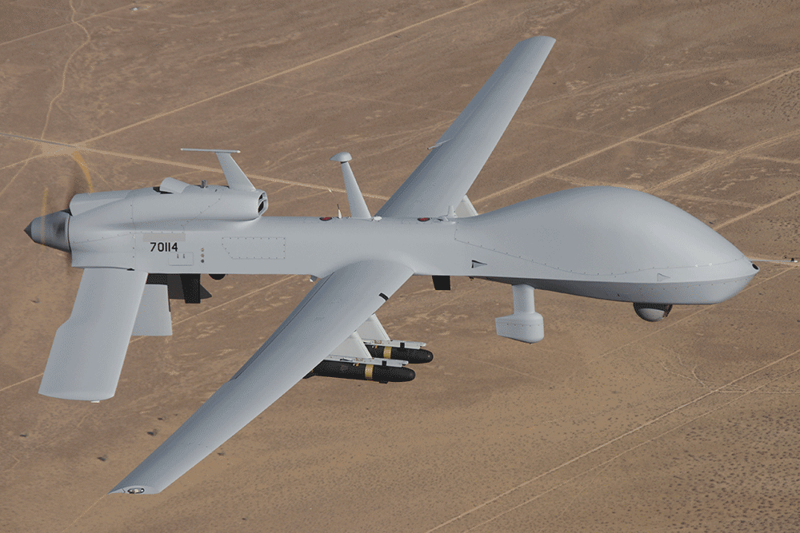
Intelligence Oversight

Slide 2

References
Army Regulation 20-1, IG Activities and Procedures
Army Regulation 381-10, The Conduct and Oversight of U.S. Army Intelligence Activities
The Intelligence Oversight Guide
Advance Sheets

Slide 3
Terminal Learning Objective
Advance Sheets Page 11
Action: Verify that U.S. Army organizations are conducting intelligence operations in accordance with law and policy.
Conditions: Given Army Regulation 20-1, Army Regulation 381-10, The Intelligence Oversight Guide, classroom handouts, and classroom instruction.
Standard: Describe accurately and thoroughly the Inspector General's Intelligence Oversight responsibilities. That description must include: a) The Inspector General's responsibilities for providing independent oversight of Army intelligence activities; b) The various types of units and staff agencies involved in intelligence activities; and c) The recommended inspection approach (methodology) for conducting Intelligence Oversight inspections.

Slide 4
Enabling Learning Objectives
Advance Sheets Page 11
ELO
Describe an IG’s responsibilities for providing independent oversight of Army intelligence activities.
2. Describe the types of units and staffs involved in intelligence activities as defined in AR 381-10, The Conduct and Oversight of U.S. Army Intelligence Activities.
3. Describe the recommended inspection methodology used by IGs to conduct Intelligence Oversight inspections as part of their command’s OIP.

Slide 5
Safety and Environmental
Safety Requirements: No other specific safety requirements are unique to this block of instruction per DA PAM 385-30, Risk Management, dated 2 December 2014.
Risk Assessment Level: Low in accordance with TRADOC Regulation 385-2, U.S. Army Training and Doctrine Command Safety and Occupational Health Program, dated 14 June 2024.
Environmental Considerations: None in accordance with AR 200-1, Environmental Protection and Enhancement, dated 13 December 2007, and ATP 3-34.5, Environmental Considerations, dated January 2024.

Slide 6
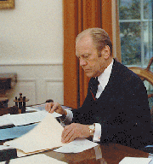
Background
During the 1960s, Army intelligence participated with other agencies in programs that aggressively collected information about U.S. citizens who were involved in the civil rights movement or opposed the war.
Great public outcry resulted from this
“Big-Brother” activity.
President Ford established some initial
rules about this type of information-
gathering activity in an Executive Order.
Currently, Executive Order 12333 establishes rules and procedures for collecting data on U.S. persons.

Slide 7
Executive Order 12333
Implementing Documents
Department of Defense (DoD) Directive 5148.13, Intelligence Oversight
DoD Manual 5240.01, DoD Intelligence Activities
Army Regulation 381-10, The Conduct and Oversight of U.S. Army Intelligence Activities, is the Army’s implementing document.
The person who can answer legal questions about this regulation is your National Security Law Attorney

Slide 8
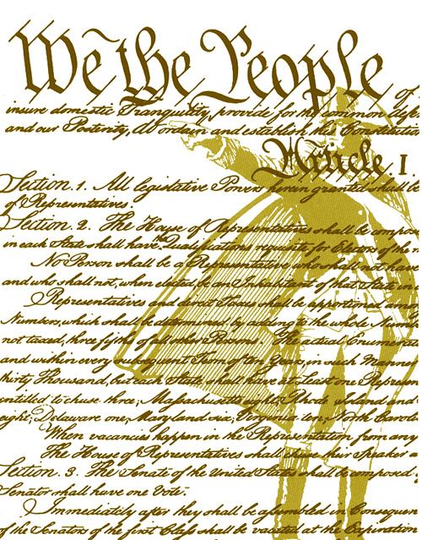
Purpose of Intelligence Oversight
Enables any Army component performing authorized intelligence functions to carry out those functions in a manner that protects the constitutional rights of U.S. persons.
Regulates particular collection techniques to obtain information for foreign intelligence or counterintelligence purposes.
AR 381-10, paragraph 1-1

Slide 9
Why is Intelligence Oversight
Important to You?
Intelligence Oversight (IO) is the only required inspection for IGs (AR 20-1, paragraph 1-4b(3a)).
IO is not a primary responsibility of the IG but rather an additional level of oversight for our intelligence elements.
IO inspections are compliance-oriented, but the findings do not result in adverse actions (unless criminal).

Slide 10
IG Responsibilities for
Intelligence Oversight
ELO
1
Army Regulation 20-1 charges all Army IGs with providing independent oversight of intelligence elements within their command.
Inspect intelligence elements conducting foreign intelligence and counterintelligence activities as part of the Organizational Inspection Program (OIP) to ensure compliance with Army Regulation 381-10 a minimum of once every two years.
Ensure that inspected personnel are familiar with the provisions of Army Regulation 381-10 (Chapters 2 and 3) and know how to report questionable intelligence activities in accordance with Chapter 4.
AR 20-1, para 1-4 b (3a) and 5-3

Slide 11
IG Responsibilities for
Intelligence Oversight
ELO
1
Report any allegations against a person in a leadership position of a Special Access Program (SAP) or Sensitive Activity (SA) to SAIG-IO in two working days.
Identify and report questionable intelligence activities (QIA). Route reports through the Commander per AR 381-10, Chapter 4. QIA reports are not IG records (AR 20-1, paragraph 5-3c). Report all QIAs within five days from discovery to SAIG-IO (National Guard Bureau…it depends).
  You can reach SAIG-IO at DSN 222-9716 or (703) 692-9716.
  Intake email Unclassified: usarmy.pentagon.hqda-otig.mesg.saig-io-office@army.mil
  Intake email SIPR: usarmy.pentagon.hqda-otig.mesg.saig-io-office@mail.smil.mil
NGB Unclass email: ng.ncr.ngb-arng.mbx.ngb-ig-intelligence-oversight@army.mil
NGB phone: (703) 607-2511

Slide 12
Questionable Intelligence Activity (QIA)
Any intelligence or intelligence-related activity when there is reason to believe such activity may be unlawful or contrary to an EO, Presidential directive, Intelligence Community Directive, or applicable DoD or Army policy governing that activity.
AR 381-10 is not in itself a punitive regulation. However, people can be subject to punishment for violations of other policies or law that are reportable under AR 381-10.
Field IGs do not investigate QIAs. Call SAIG-IO for guidance on courses of action to take and how to handle evidence provided to your office.
AR 381-10, Glossary

Slide 13
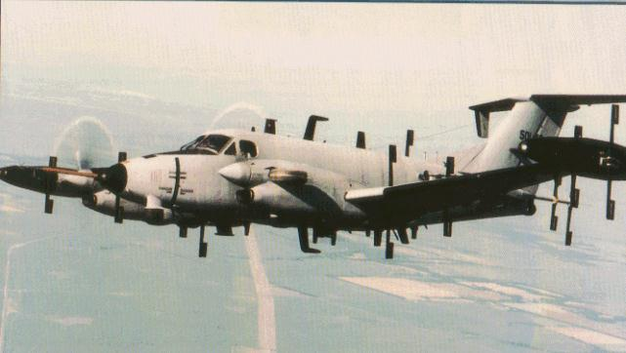
AR 381-10 Applies to . . .
ELO
2
Intelligence elements.
Anyone employed by, assigned to, or acting for Army intelligence elements when conducting intelligence activities under SECARMY authorities.
(Foreign intelligence or counterintelligence purposes)
AR 381-10, Chapter 3

Slide 14
Intelligence Elements
What are they?
Some Examples:
HQDA, G-2 / INSCOM
650th MI Group, SHAPE
ICoE and other organizations conducting intel training
Intelligence systems developers when developing or testing systems
When carrying out intelligence activities as defined in DoDM 5240.01 under the authority of the SECARMY:
  Installation, organization, facility, or program security offices
  G-2 / S2 / MI Units Contractors supporting any Army entity
  Any other Army entity
        AR 381-10, Glossary

Slide 15
AR 381-10 Does not apply to:
Unit administrative activities – social rosters, Non-combatant Evacuation Operations (NEO) packets, etc.
Civil disturbance activities
Law-enforcement activities
Criminal intelligence activities of the Provost Marshal and the CID

Slide 16
Intelligence Oversight
ELO
3
Inspection Methodology
Personnel to Interview (Interviews and Sensing Sessions)
Documents to Review
Events to Observe
Where can I find the specifics?
  The Intelligence Oversight Guide

Slide 17
Inspection Methodology
Personnel to Interview
(Interviews and Sensing Sessions)
Division and Corps G-2s
Commander / XO / CSM / S-3 or equivalents of units conducting foreign intelligence (FI) and counterintelligence (CI) activities
Intelligence Oversight Officers at all levels (i.e., within G-2 staff elements and Intelligence battalions)
Functional managers for CI, Geospatial Intelligence (GEOINT), Human Intelligence (HUMINT), Signals Intelligence (SIGINT), Open-Source Intelligence (OSINT), and all source intelligence analysis
Company Commanders and First Sergeants of units containing intelligence elements
Elements (teams and sections) containing Soldiers and Civilians executing FI and CI activities

Slide 18
Inspection Methodology
Documents to Review
Multi-discipline intelligence collection, analysis, and production mission and authorities (i.e., EXORDS / OPORDS up to and including SEC Army or Combatant Command granting authority) for the conduct of FI / CI
Results of staff inspections of IO inspections (current and / or previous year, to include staff inspections of the G-2 staff)
Command OIP policies and implementing orders re: IO
Command intelligence oversight policies, implementing orders, and intelligence oversight officer appointments
Command intelligence oversight training materials and records.
Formal (i.e. orders) and informal (i.e., standard operating procedures and similar documents) describing how the command executes, supervises, and oversees the conduct of FI / CI activities

Slide 19
Inspection Methodology
Events to Observe
Intelligence oversight training
Any training events for multi-discipline intelligence collection, analysis, and production
Staff inspections of intelligence oversight
Foreign intelligence and counterintelligence training exercises
Foreign intelligence and counterintelligence activities

Slide 20
ELO Check on Learning
ELO 1: Describe an IG’s responsibilities for providing independent oversight to intelligence activities.
Inspect all intelligence elements within the DA’s purview every 2 years, AND
Report allegations against leaders of SA / SAP within 2 working days
Report QIAs within 5 days of discovery
(AR 381-10)

Slide 21
ELO Check on Learning
ELO 2: Describe the types of units and staffs involved in intelligence activities.
Those operating under the authority of the Secretary of the Army
ELO 3: Describe the recommended Inspection Methodology to conduct IO inspections.
Personnel to interview / sense, documents to review, events to observe
(AR 381-10)

Slide 22
TLO Check on Learning
Action: Verify that U.S. Army organizations are conducting intelligence operations in accordance with law and policy.
Conditions: Given Army Regulation 20-1, Army Regulation 381-10, The Intelligence Oversight Guide, classroom handouts, and classroom instruction.
Standard: Describe accurately and thoroughly the Inspector General's Intelligence Oversight responsibilities. That description must include: a) The Inspector General's responsibilities for providing independent oversight of Army intelligence activities; b) The various types of units and staff agencies involved in intelligence activities; and c) The recommended inspection approach (methodology) for conducting Intelligence Oversight inspections.

Slide 23
Summary
During the Intelligence Oversight BOI, we:
Described an IG’s responsibilities for providing independent oversight to intelligence activities.
Described the types of units and staffs involved in intelligence activities.
Described the recommended Inspection Methodology to conduct IO inspections.

Slide 24

Questions?

